Slide 1

Block Chain
By Alex Joslin

Slide 2


What is a block chain?
It is a decentralized peer-to-peer network used to validate crypto currency transactions.

Slide 3

Bitcoin Blockchain
From:
To:
Amount:
Hash:
Hash of prev block:
From:
To:
Amount:
Hash:
Hash of prev block:
From:
To:
Amount:
Hash:
Hash of prev block:

Slide 4
Bitcoin Blockchain
Genesis Block
From: None
To: None
Amount: None
Hash:
K33iksinc5udD0a...
Hash of prev block:
00000000000000...
From:👨🏻
To:👩🏽‍🦳
Amount: 1.5
Hash:
dh4jsi48Soi23N6x...
Hash of prev block:
K33iksinc5udD0a...
From: 👩🏼‍🦱
To:🧓🏻
Amount: 0.3
Hash:
e7n22pD6M3Aq2...
Hash of prev block:
dh4jsi48Soi23N6x...

Slide 5
Proof of work
A Mechanism to slow down the creation of new blocks.
For bitcoin it takes around 10 minutes to create a new block.
This is done for security purposes.

Slide 6
Hacking The blockchain
From: 🧓🏻
To: 👨🏼‍🦰
Amount: 0.27
Hash:
K33iksinc5udD0a...
Hash of prev block:
sjs9do5HeW4M2...
From:👨🏻
To:👩🏽‍🦳
Amount: 1.5
Hash:
dh4jsi48Soi23N6x...
Hash of prev block:
K33iksinc5udD0a...
From: 👩🏼‍🦱
To:🧓🏻
Amount: 0.3
Hash:
e7n22pD6M3Aq2...
Hash of prev block:
dh4jsi48Soi23N6x...

Slide 7
Hacking The blockchain
From: 🧓🏻
To: 👨🏼‍🦰
Amount: 3.5
Hash:
K33iksinc5udD0a...
Hash of prev block:
sjs9do5HeW4M2...
From:👨🏻
To:👩🏽‍🦳
Amount: 1.5
Hash:
dh4jsi48Soi23N6x...
Hash of prev block:
K33iksinc5udD0a...
From: 👩🏼‍🦱
To:🧓🏻
Amount: 0.3
Hash:
e7n22pD6M3Aq2...
Hash of prev block:
dh4jsi48Soi23N6x...

Slide 8
Hacking The blockchain
From: 🧓🏻
To: 👨🏼‍🦰
Amount: 3.5
Hash:
niuU4g2L1Wbz9Z...
Hash of prev block:
sjs9do5HeW4M2...
From:👨🏻
To:👩🏽‍🦳
Amount: 1.5
Hash:
dh4jsi48Soi23N6x...
Hash of prev block:
K33iksinc5udD0a...
From: 👩🏼‍🦱
To:🧓🏻
Amount: 0.3
Hash:
e7n22pD6M3Aq2...
Hash of prev block:
dh4jsi48Soi23N6x...

Slide 9
Hacking The blockchain
Rehash all blocks?
From: 🧓🏻
To: 👨🏼‍🦰
Amount: 3.5
Hash:
niuU4g2L1Wbz9Z...
Hash of prev block:
sjs9do5HeW4M2...
From:👨🏻
To:👩🏽‍🦳
Amount: 1.5
Hash:
dh4jsi48Soi23N6x...
Hash of prev block:
K33iksinc5udD0a...
From: 👩🏼‍🦱
To:🧓🏻
Amount: 0.3
Hash:
e7n22pD6M3Aq2...
Hash of prev block:
dh4jsi48Soi23N6x...

Slide 10
Hacking The blockchain
From: 🧓🏻
To: 👨🏼‍🦰
Amount: 3.5
Hash:
niuU4g2L1Wbz9Z...
Hash of prev block:
sjs9do5HeW4M2...
From:👨🏻
To:👩🏽‍🦳
Amount: 1.5
Hash:
sd5KfoE3jsN93ub...
Hash of prev block:
niuU4g2L1Wbz9Z...
From: 👩🏼‍🦱
To:🧓🏻
Amount: 0.3
Hash:
hsC49jsMA2kKS23...
Hash of prev block:
sd5KfoE3jsN93ub...

Slide 11
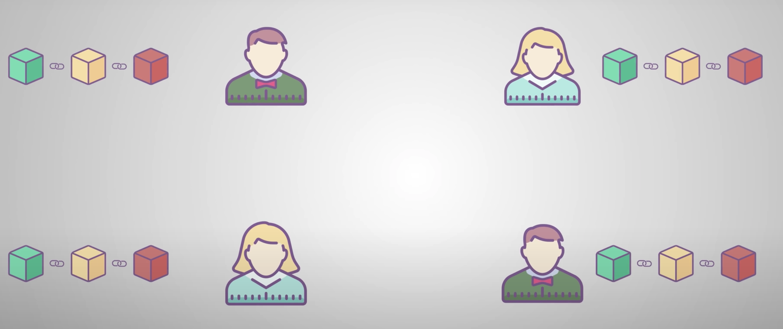
Peer to Peer Network
Every time a new user joins the block chain, they get a copy of it

Slide 12
Peer to Peer Network
Every time a new user joins the block chain, they get a copy of it

Slide 13
Peer to Peer Network
Every time a new user joins the block chain, they get a copy of it

Slide 14
Peer to Peer Network
Every time a new user joins the block chain, they get a copy of it

Slide 15
Peer to Peer Network
Every time a new user joins the block chain, they get a copy of it

